Slide 1
Web-Based Database and SMS to Facilitate Healthcare Medical Emergency

Slide 2
INDEX
Abstract
Introduction
Literature review
Existing Method
Drawbacks
Proposed method
Advantages
Block Diagram
Implementation
Hardware and Software Requirements
UML Diagrams

Slide 3
ABSTRACT
Healthcare and medical emergency are essential systems in human life; so that many countries work toward having it. Investigation of Malaysian case shows that it suffer from locality, missing of unified electronic medical record EMR and lack of utilizing Internet, multimedia, wireless and real time technologies.
This leads to difficulty in communication, hard to manage and exchange patient data between various medical units. The fully computerizing and combining of such medical systems will lead to produce a Novel Integrated Healthcare Medical Emergency Model (IHMEM). IHMEM involves web-based database, intelligent agent and sms facility where an agent can give reply to patients about their need. All hospitals, healthcare and emergency centers can view the patient record simultaneously, exchanging, managing and collaborate on sharing resources between medical units.

Slide 4
Problem Statement
It is difficult to incorporate the various challenges related to patient information into an emergency system requirement.

Slide 5
INTRODUCTION
Many hospitals and emergency centers are not efficient enough because the big number of emergency cases, which is not easy to be handled. In an emergency department, most likely a nurse will determine the severity of the wound and check patient’s vital signs such as temperature, blood pressure and heart rate. Additional personal information and medical history have to be obtained. In case patient’s information is stored in another clinic or hospital they have to be obtained. Unless the patient has brought the personal file along, getting the required information will slow down the process. An emergency physician will have to examine the patient. In some cases, the patient needs great attention and sometimes the surgery room or other devices will be needed. All these will have to be arranged in timely manner, which in general is not the case.

Slide 6
LITERATURE REVIEW
S. NO | Application Type with year | Authors | Title | Outcomes
1 | Report (2006) | Shihab A. Hameed, Shahina Shabnam | Integrated Medical and Emergency System | Unified electronic medical record EMR used in all medical centers.

Slide 7
LITERATURE REVIEW
S. NO | Application Type with year | Authors | Title | Outcomes
2 | Report (2006) | Shihab A. Hameed, Shahina Shabnam | An Intelligent Agent-Based Medication and Emergency System | This project is to develop an intelligent agent-based medication and emergency system

Slide 8
LITERATURE REVIEW
S. NO | Application Type with year | Authors | Title | Outcomes
3 | Report (2006) | Shihab A. Hameed, B.A. Aliyu | WIMAX Wireless Technology to enhance an Integrated Emergency and Guidance System | An integrated emergency and guidance system based on WiMAX was proposes to overcome such problems.

Slide 9
EXISTING SYSTEM
Compared to existing medical related telemedicine application, Telemedicine can be defined as the use of audio, video, and other telecommunications and electronic information processing technologies to provide health services or assist health care personnel at distant sites. However, telemedicine may not suit every person or situation. Protecting medical data in such applications like, Hackers and other criminals may be able to access a patient’s medical data, especially if the patient accesses telemedicine on a public network or via an unencrypted channel.

Slide 10
DISADVANTAGES
Accessing telemedicine may delay treatment.
Hackers may access patient’s medical data.
An inability to examine patients

Slide 11
PROPOSED SYSTEM
In this proposed method, we use the Integrated Healthcare Medical Emergency Model, which can provide stakeholders with related medical information. The registered users can logon to the system and they can search nearby medical centers which provide all hospital information with emergency units and the users/patients can simply send an sms to medical center and the medical center can give reply about the information.

Slide 12
ADVANTAGES
Provides all treatment and emergency wards for patients.
Data will be in safe because the sms system here is a protected and it only operated by one agent/medical centers.
Gives suggestions for good health

Slide 13
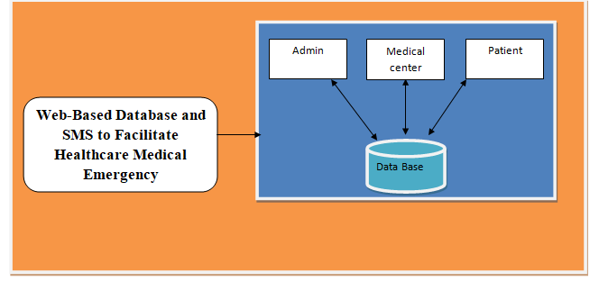
Block Diagram

Slide 14
Modules
Admin : Admin login with valid credentials.
After Logging, the admin has to accept the new registered medical centers.
The Admin can view the medical center and Patient Details.
Medical Center:
Medical Center can register by entering all the details. And login with valid credentials.
After Logging , Medical center can add about the information of all available emergency units .health care can View the profile, and add update and delete the features..
Patient :
Initially Register, and login with valid credentials.
After Logging , the patient can view the profile . Patient can search for medical center and can send sms to them for emergency unit.

Slide 15
SYSTEM REQUIREMENTS
Software Requirements
Operating System : Windows 7+
Application Server : Tomcat 7.0
Front End : HTML, JSP,CSS
Scripts : JavaScript.
Backend Language : Java
Database : MySQL 6.0
IDE : Eclipse(2019-3)

Slide 16
SYSTEM REQUIREMENTS
Hardware Requirements
Processor - Intel i3
RAM - 4GB
Hard Disk - 500 GB

Slide 17
UML Diagrams
UML stands for Unified Modeling Language. UML is a standardized general-purpose modeling language in the field of object-oriented software engineering. The standard is managed, and was created by, the Object Management Group.
The goal is for UML to become a common language for creating models of object oriented computer software. In its current form UML is comprised of two major components: a Meta-model and a notation. In the future, some form of method or process may also be added to; or associated with, UML.
The Unified Modeling Language is a standard language for specifying, Visualization, Constructing and documenting the artifacts of software system, as well as for business modeling and other non-software systems.
The UML represents a collection of best engineering practices that have proven successful in the modeling of large and complex systems.
The UML is a very important part of developing objects oriented software and the software development process. The UML uses mostly graphical notations to express the design of software projects.

Slide 18
Use case diagram
A use case diagram in the Unified Modeling Language (UML) is a type of behavioral diagram defined by and created from a Use-case analysis. Its purpose is to present a graphical overview of the functionality provided by a system in terms of actors, their goals (represented as use cases), and any dependencies between those use cases. The main purpose of a use case diagram is to show what system functions are performed for which actor. Roles of the actors in the system can be depicted.

Slide 19
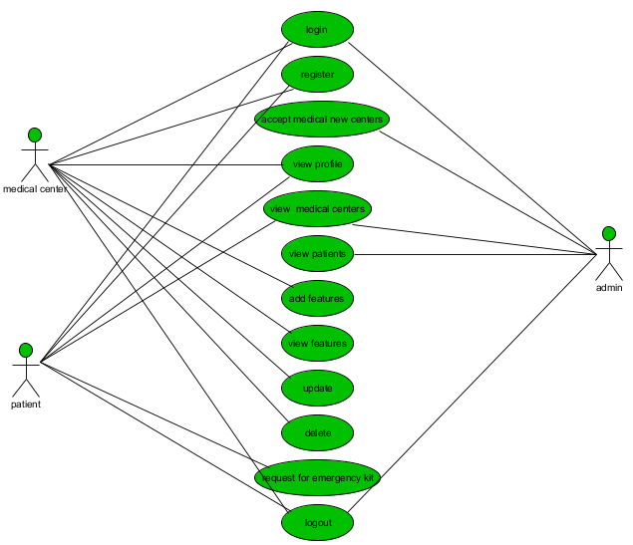

Slide 20
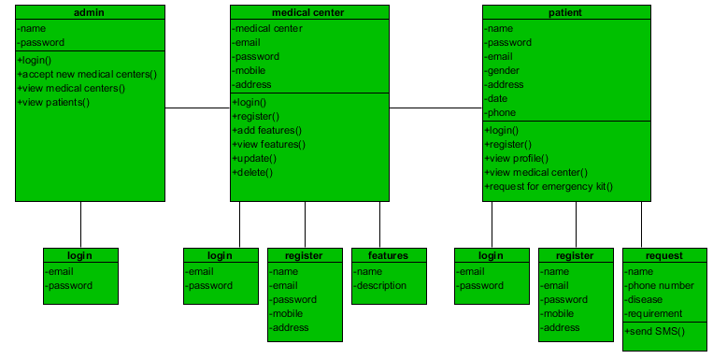
Class diagram
In software engineering, a class diagram in the Unified Modeling Language (UML) is a type of static structure diagram that describes the structure of a system by showing the system's classes, their attributes, operations (or methods), and the relationships among the classes. It explains which class contains information

Slide 21
Sequence diagram
A sequence diagram in Unified Modeling Language (UML) is a kind of interaction diagram that shows how processes operate with one another and in what order. It is a construct of a Message Sequence Chart. Sequence diagrams are sometimes called event diagrams, event scenarios, and timing diagrams .

Slide 22
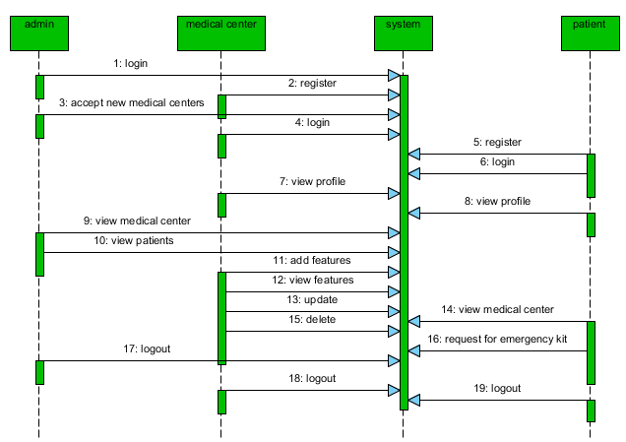
Sequence diagram

Slide 23
activity diagram
Activity diagrams are graphical representations of workflows of stepwise activities and actions with support for choice, iteration and concurrency. In the Unified Modeling Language, activity diagrams can be used to describe the business and operational step-by-step workflows of components in a system. An activity diagram shows the overall flow of control.

Slide 24
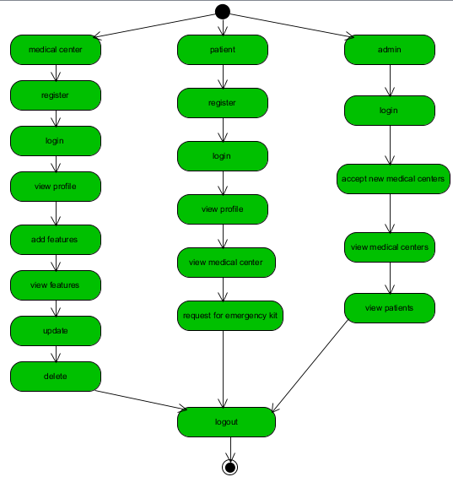
activity diagram

Slide 25
Collaboration diagram
In collaboration diagram the method call sequence is indicated by some numbering technique as shown below. The number indicates how the methods are called one after another. We have taken the same order management system to describe the collaboration diagram. The method calls are similar to that of a sequence diagram. But the difference is that the sequence diagram does not describe the object organization whereas the collaboration diagram shows the object organization.

Slide 26
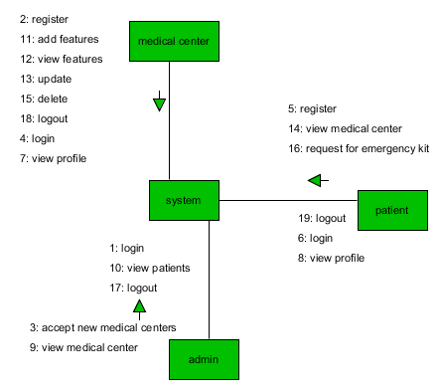

Slide 27
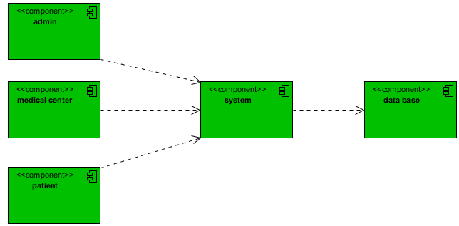
Component diagram
Component diagrams are used to describe the physical artifacts of a system. This artifact includes files, executables, libraries etc. So the purpose of this diagram is different, Component diagrams are used during the implementation phase of an application. But it is prepared well in advance to visualize the implementation details. Initially the system is designed using different UML diagrams and then when the artifacts are ready component diagrams are used to get an idea of the implementation.

Slide 28
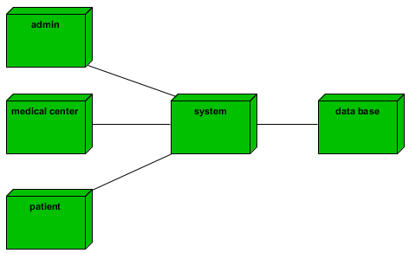
Deployment diagram
Deployment diagram represents the deployment view of a system. It is related to the component diagram. Because the components are deployed using the deployment diagrams. A deployment diagram consists of nodes. Nodes are nothing but physical hardware’s used to deploy the application.

Slide 29
Er diagram
An Entity–relationship model (ER model) describes the structure of a database with the help of a diagram, which is known as Entity Relationship Diagram (ER Diagram). An ER diagram shows the relationship among entity sets. An entity set is a group of similar entities and these entities can have attributes. In terms of DBMS, an entity is a table or attribute of a table in database, so by showing relationship among tables and their attributes, ER diagram shows the complete logical structure of a database.

Slide 30
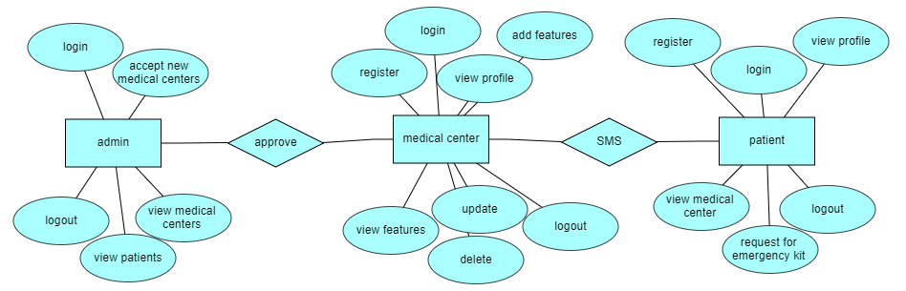

Slide 31
DFD diagram
A Data Flow Diagram (DFD) is a traditional way to visualize the information flows within a system. A neat and clear DFD can depict a good amount of the system requirements graphically. It can be manual, automated, or a combination of both. It shows how information enters and leaves the system, what changes the information and where information is stored.
The purpose of a DFD is to show the scope and boundaries of a system as a whole. It may be used as a communications tool between a systems analyst and any person who plays a part in the system that acts as the starting point for redesigning a system

Slide 32
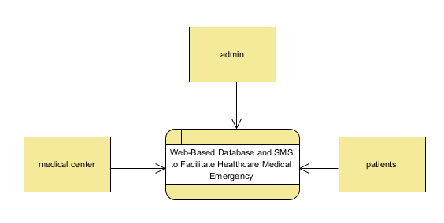
Context level diagram

Slide 33
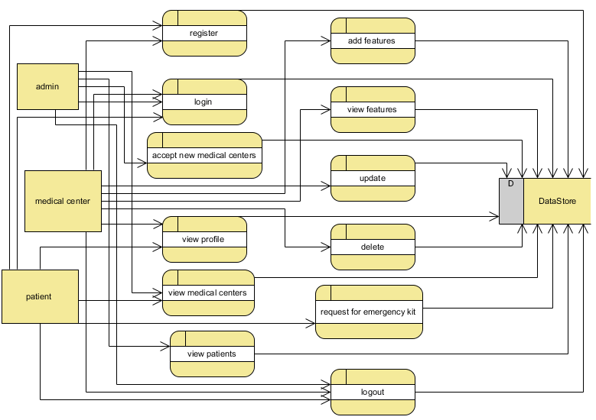
DFD diagram – Level 1

Slide 34
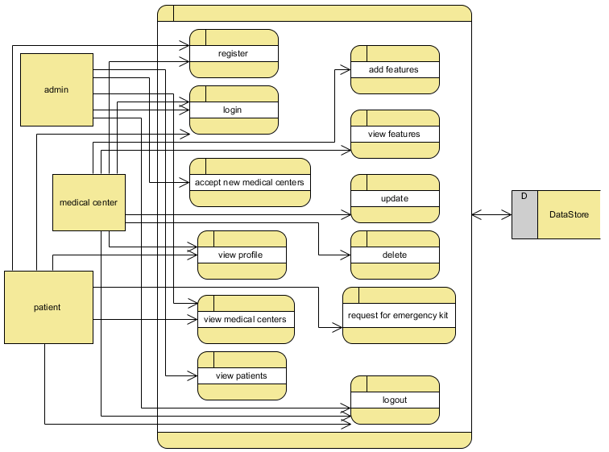
dfd diagram – Level 2

Slide 35
References
[1] National research Council, Networking Health: Prescription for the Internet, National Academy Press, Washington, 2000
[2] Shihab A. Hameed, Shahina Shabnam, “Integrated Medical and Emergency System”, ICCCE06, Malaysia 2006
[3] Shihab A. Hameed, Shahina Shabnam, “An Intelligent Agent-Based Medication and Emergency System”, ICTTA06, Syria 2006
[4] Leslie Versweyveld, Virtual Medical Worlds, http://www.hoise.com/vmw/02/articles/vmw/LV-VM-03-02-33.html
[5] Warner MD, Malaysian Medical Matrix: Telemedicine in the age of Multimedia Super Corridor, http://www.pulsar.org/febweb/papers/m3web.htm

Slide 36
References
[6] Materia Medica Malaysiana, Putrajaya hospital showcases latest eHealth service,http://medicine.com.my/mblog/2004/08/putrajaya-hospitalshowcases-latest.html
[7] A Guide to Setting up a Workplace Safety and Health Program, http://www.safemanitoba.com/pdf/wshprogram_setup_guide.pdf
[8] Shihab A. Hameed, B.A. Aliyu, “WIMAX Wireless Technology to enhance an Integrated Emergency and Guidance System”, Accepted in ISM06, UAE 2006
[9] http://www.acponline.org/computer/telemedicine/glossary.htm
[10] The MOMEDA project. http://www.biomed.ntua.gr/ momeda

